Slide 1
DR.SANJU.S ASSISTANT PROFESSOR DEPT OF FORENSIC MEDICINE AND TOXICOLOGY
VEGETABLE IRRITANTS

Slide 2
PHYTOTOXIN
A toxic protein , which resembles bacterial toxin in action & causes agglutination of red cells with some haemolysis.
Phytotoxin is a toxin produced by plant.
Animal toxalbumens are snake & scorpion venoms.

Slide 3
RICINUS COMMUNIS(CASTOR)
FRUIT- 1.2 to 2.5 cm long. three lobed ,soft spiny, blue green or rose red when immature, brown and bristly when ripe and dry.
TOXALBUMEN – Ricin.
Entire plant is poisonous though seeds are most poisonous.
Unbroken seeds are non poisonous when swallowed and when cooked.

Slide 4
RICINUS COMMUNIS
ACTION
Blocks protein synthesis through inhibition of RNA polymerase.
6000 times more powerful than cyanide

Slide 5
RICINUS –SIGNS AND SYMPTOMS
Dust of seeds may cause watering of eyes, conjunctivitis, sneezing, acute nasal inflammation ,headache, pharyngitis, asthmatic bronchitis, dermatitis and gastric upset.
Burning in mouth, throat and stomach, oral mucosa, salivation, nausea, vomitting bloody diarrhoea, severe abdominal pain and thirst.

Slide 6
Ricinus fruit & seed.
FRUIT
SEED
FRUIT-1.2 to 2.5 cm. long.
3 lobed,ss,bg,rr when immature.
brown & bristly when ripe
Entire plant is poisonous.
SEED – variable ,smooth ,flattened ,oval ,mottled & dark brown or white with yellow brown or gray markings or wholly black or red. Size – big & small. small seeds are 1.2 cm long & 0.8 cm broad & resemble croton seeds. MOST POISONOUS

Slide 7
RICINUS –SIGNS AND SYMPTOMS
Impaired sight, weak rapid pulse, cramps in calves and abdominal muscles ,haemolysis, drowsiness, delirium , convulsions, shallow breathing, uraemia, jaundice, dehydration, collapse and death

Slide 8
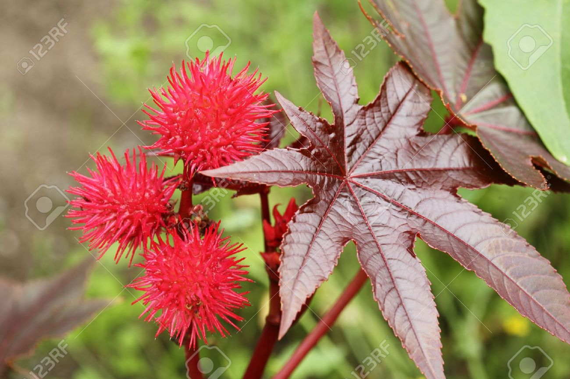
RICINUS COMMUNIS

Slide 9
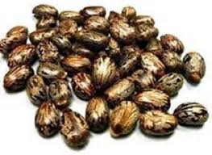
RICINUS COMMUNIS - SEEDS

Slide 10
FD,FP ,TREATMENT & PM
FD – 5 to 10 seeds
FP – Two to five days
TREATMENT- Gastric lavage,activated charcoal, demulcents, cathartics & symptomatic
PM – Haemorrhagic inflammation of GI tract, dialation of heart , haemorrhages in pluera, pericardium oedema of organs. fragments of seeds in stomach or intestine.

Slide 11
CIRCUMSTANCES OF POISONING
Accidental – children eats the seeds.
Rarely homicidal
Conjunctivitis – when powder of seeds are applied to eyes.

Slide 12
ABRUS PRECATORIOUS
JEQUIRITY, INDIAN LIQUORICE, ROSARY BEAD, GUNJA OR RATI.
Climbing plant ,woody at base, leaves are compound feather like, seeds are egg shaped scarlet colour with a large spot at one end.
ACTIVE PRINCIPLE- Abrin similar to viperine snake venom

Slide 13
ABRUS PRECATORIUS
Climber, woody at base. Leaves- feather like.
Flowers – pea –like. long ,purple,pink, yellowish or whitish.
Seed- egg shaped ,bright scarlet colour with a black spot at one end.odorless &tasteless.
Contains abrin , a toxalbumen which is similar to viperine snake venom; & abrine (N- methyl tryptophan) , an amino acid, haemoglutinin in the cotyledons; & abralin, a glucoside.

Slide 14
ABRUS PRECATORIOUS

Slide 15
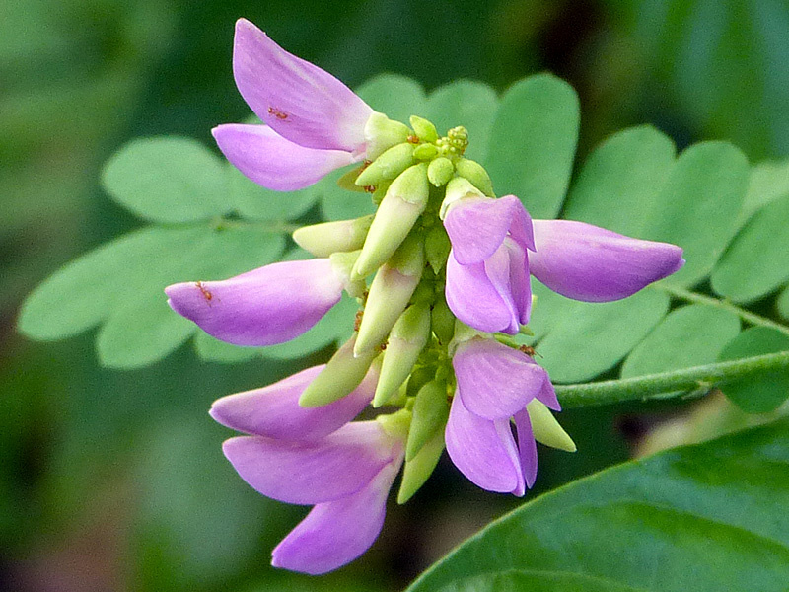
ABRUS PRECATORIOUS

Slide 16
SIGNS AND SYMPTOMS
Symptoms are delayed when taken by mouth.
Severe irritation of upper GI tract, abdominal pain, nausea, vomitting, bloody diarrhoea, weakness,cold perspiration, trembling of hands, weak rapid pulse, miosis and rectal bleeding. Delayed cytotoxic effects occur in CNS, liver, kidneys and adrenal glands 2 to 5 days after exposure

Slide 17
AS A CATTLE POISON
When an extract of seeds are injected under the skin of the animal, inflammation ,oedema, oozing of haemorrhagic fluid from the site of puncture and sometimes necrosis occurs surrounding the site of injection. The animal does not take food and drops down after 3 to 4 days and cannot move. Tetanic convulsions or the animal becomes cold ,drowsy or comatose and dies. The symptoms resembles those of viperine snakebite.

Slide 18
IN MAN
At the site of injection ,painful swelling and ecchymosis develops, with inflammation and necrosis. Ingestion of seeds or extract can cause haemorrhagic gastritis.There is faintness ,vertigo, vomiting, dyspnoea and general prostration. Convulsions may precede death from cardiac failure.

Slide 19
FD,FP,TREATMENT & PM
FD-90 to 120 mg.(one to 2 seeds) by injection.
FP- 3 to5 days.
TREATMENT- Gastric lavage, Activated charcoal, Purgative, Injection of antiabrin. The needle should be dissected .Sodium bicarbonate.10 g orally per day.
PM –Fragments of needle, oedema at the site of injection and petechial haemorrhages under the skin, pleura, pericardium and peritonium. congestion & haemorrhages.

Slide 20
AS OF VIPERINE SNAKE BITE
PREPARATION OF SUIS- The seeds are decorticated and alone or mixed with datura, opium and onion are made into paste with spirit and water and small pointed spikes or needles or suis are prepared which are then dried in sun. The needles are 15mm long and weigh 90 to 120mg .Two needles are inserted by their base into holes in a wooden handle. A blow is struck into the flesh.

Slide 21
CIRCUMSTANCES OF POISONING
Seeds are used for killing cattle, by leather workers to obtain hides.
For homicide ,the needle is kept between two fingers & the person is slapped which drives the needle into the body.
Powdered seeds are used by malingerers to produce conjunctivitis.
Prevents conception , abortifacient.
Arrow poison.

Slide 22
CROTON TIG
Toxalbumen – crotin.
Seeds are oval ,dark brown with longitudinal lines.
Oil is brown, viscid, has unpleasant odour and acrid burning taste but does not contain toxalbumen.

Slide 23
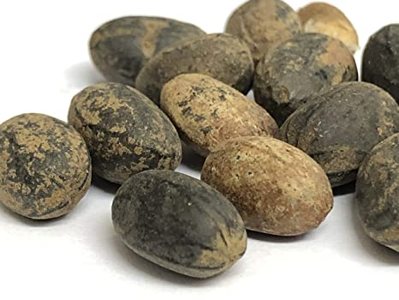
CROTON TIG

Slide 24
CROTON TIG-SYMPTOMS,FD & FP
Hot burning pain from mouth to stomach, salivation vomiting , purging, vertigo, prostration, collapse and death. On skin the oil produces burning, redness and vesication.
FD – 4 to 5 seeds,1 to 2 ml oil
FP- 6 hrs to 3 days.
PM – congestion, inflammation & erosion

Slide 25
ERGOT
Dried sclerotinum of the fungus Claviceps purpurea, which grows on cereals like rye, barley ,wheat ,oats ,etc.It replaces the grain forming a curved, dark purple or black compact mass, 0.9 to 1 cm.long half cm thick , with lengthwise ridges and has peculiar odour & disagreeable taste.
Alkaloids - 30. in no.
3 are important.Ergotoxin ,ergotamine &
erogometrine (ecbolics).

Slide 26
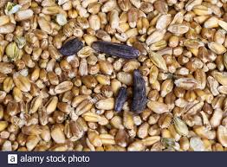
ERGOT
Dried sclerotinum of the fungus Claviceps purpurea ,which grows on cereals like rye, barley, wheat, oats etc.

Slide 27
ACTION,FD,FP,TREATMENT
ACTION – stimulates adrenergic receptors , both peripherally & centrally. They directly stimulates muscle fibres.
FD - 2 to 10 g.
FP - 1 to several days.
TREATMENT – SW,AC , syrup of ipecac , c ,nitropruside for htn & ischemic changes, diazepam 0.1 mg .i.v. slowly for convulsions & vasodilators.

Slide 28
ERGOTISM
CHRONIC POISONING – In CONVULSIVE TYPE -twitching ,tingling, numbness & pain in muscles.
Sensation of insects creeping under the skin.
Neurological disorder characterised by hallucinations, ataxia & convulsions .

Slide 29
ERGOTISM
In GANGRENOUS TYPE –there is burning pain(called St.Anthony’s fire) in limbs with inflammation & swelling.vesication ,gangrenous ulceration & sloughing .Dry gangrene of fingers ,toes , ears ,nose or hands & feet occurs.

Slide 30
CAPSICUM ANNUM
ACTIVE PRINCIPLE – Capsaicin.
NOT FATAL .
CRIMINAL USE-
Powder is thrown into eyes to facilitate robbery.
Torture by introducing into vagina, rectum ,urethra or by rubbing into female breasts

Slide 31
CAPSICUM
CHILLIES(red pepper;mirch) have a pungent odour & taste & are used as a condiment .
They are not fatal.
ACTIVE PRINCIPLE – CAPSSAICIN & CAPSICIN.
Irritant poison & causes difficulty in swallowing ,pain in stomach & inflammation.
Irritation on skin & on eyes it produces lachrymation , burning & redness.

Slide 32
CAPSICUM
Rx - bathe affected skin in vinegar or ice cold water.
- if ingested , sucking of ice cubes or sips of ice cold water.
CRIMINAL USES - powder is thrown into eyes to facilitate robbery.
- when theft or confession of some guilt has to be obtained ,the person is tortured by introducing the powder into vagina , rectum ,urethra or by rubbing on female breast.

Slide 33
CAPSICUM

Slide 34
CAPSICUM

Slide 35
SEMECARPUS ANACARDIUM

Slide 36
SEMECARPUS ANACARDIUM
ACTIVE PRINCIPLE – semecarpol (0.1%) & bhilawanol (1.5 to 17%).
FD – 5 to 10 g
FP – 12 to 24 hrs
TREATMENT –
Gastric lavage
Demulcent
Externally wash with luke warm water containing antiseptic

Slide 37
SIGNS AND SYMPTOMS
Applied externally ,juice causes irritation and a painful blister which contains acrid serum which produces eczematous eruptions of neighbouring skin with which it comes into contact and there is itching. The lesion resembles bruise. Later ulcer develops & there may be sloughing. By mouth in large doses produce blisters on throat & severe GI irritation, dyspnoea, tachycardia, hypertension, cyanosis, absence of reflexes, delirium ,coma & death

Slide 38
DIFFERENTIATE FROM BRUISE
POINTS | BRUISE | LESIONS DUE TO SEMICARPUS
SHAPE | Regular | Irregular
MARGIN | Diffused | Sharp & clear
SWELLING | present | Absent
COLOUR CHANGE | Occurs | Does not occur
ITCHING | absent | Present
BLISTERS | Absent | Present on margin
CAUSE | Rupture of capillaries | Chemical change
EXTRAVASATION IN TISSUES | Present | absent
NAIL BEDS | Nothing | Similar lesion

Slide 39
CIRCUMSTANCES OF POISONING
Accidental poisoning may result from administration of juice internally by quacks. Sometimes juice is introduced into vagina as a punishment for infidelity. To support a false charge of assault juice is applied to skin which produce lesions simulating bruises. Juice thrown into body to cause injury. For criminal abortion. Malingerers use the juice to produce ophthalmia

Slide 40
CALOTROPIS
Calotropis gigantea - purple flower.
Calotropis procera – white flower
ACTIVE PRINCIPLE – uscharin ,calotoxin and calotropin(glycoside).
WHEN APPLIED TO SKIN PRODUCES REDNESS AND VESICATION.
The root is highly poisonous to cobras and other poisonous snakes

Slide 41
CALOTROPIS

Slide 42
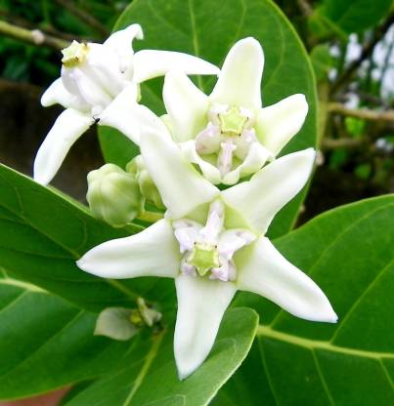
CALOTROPIS

Slide 43
SIGNS AND SYMPTOMS
ORALLY – acrid bitter taste, burning pain in throat and stomach, salivation,stomatitis, vomiting,diarrhoea,dilated pupils, tetanic convulsions, collapse and death

Slide 44
CALOTROPIS
FP -6 TO 12 Hrs.
TREATMENT – Stomach wash, demulcents and symptomatic.
PM - Dilated pupils,froth at the nostrils, stomatitis and inflammation of GIT. Abdominal viscera and and brain are congested.

Slide 45
CIRCUMSTANCES OF POISONING
Flowers, leaves and fruits are used in Indian medicine.
For criminal abortion
Rarely for suicide, homicide and infanticide
Juice is used as vesicant, depilatory and for chronic skin infection.
Occasionally to produce artificial bruise
As a cattle poison.

Slide 46
ANIMAL POISON
Cantharides
Scorpion
Snakes

Slide 47
CANTHARIDES

Slide 48
CANTHARIDES
SPANISH FLY (BLISTER BEETLE)
2cm long & 0.6cm broad.
Powder of dried body is greyish brown & contains shiny green particles.
ACTIVE PRINCIPLE – cantharidin.
locally irritant & NEPHROTOXIC.
Indian fly is 2.5 cm long & 0.8 cm broad.
Contains 2.9% cantharidin
Cantharidin is readily absorbed from all surfaces.

Slide 49
SYMPTOMS
On skin –redness & burning are produced after 2 to 3 hrs followed by vesication.
Internally , within half to two hrs , burning sensation in mouth & throat, followed by pain in stomach , nv of bloody mucus , severe thirst, dysphagia & difficulty in speech. Dull pain in loins .urine is scanty & blood stained . priapism & tenesmus.abortion ; prostration , convulsions coma & death

Slide 50
BLISTERS

Slide 51
FD , FP ,Rx & PM APP
FD – 15 to 50 mg of cantharidin or one & half to 3 g of powdered cantharides.
FP- 24 to 56 hrs.
Rx - SW , D & S .
PM - inflammation , vesication , swelling , ulceration , congestion , petechial haemorrhages , erosion from mouth to upper small intestine. Particles of insect sticks to mucosa . Urinary organs – inflamed & hemorrhagic. Hemorrhagic heart & lungs.

Slide 52
CIRCUMSTANCES OF POISONING
Accidental poisoning by its external application as counter irritant.
Aphrodisiac.
Criminal abortion.

